Slide 1

MEMBER 1
Optimal Microservices Granularity
Assignment 3: Balancing Business Alignment and Technical Optimization
Basant Awad 22101405
Nadira Mohamed 22101377
Merna Adel 22101164
Ahmed Adel 22101163
Mohamed Alsariti 22101901
Ahmed Yahia 21100913

Slide 2
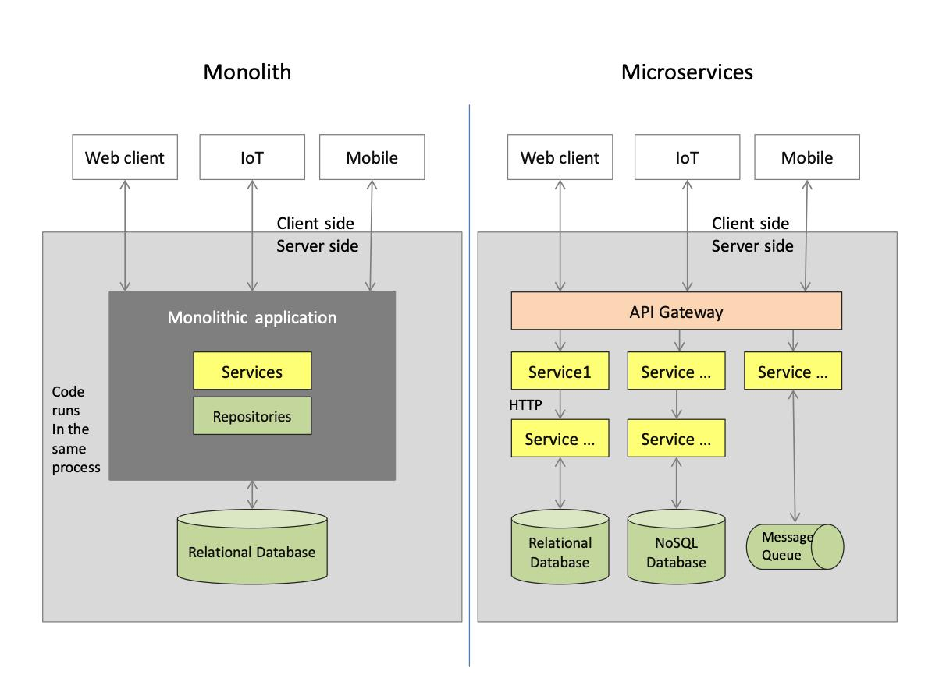

MEMBER 1
What are Microservices
Architecture style where applications are divided into small independent services.
Each service has:
own logic
own deployment
communication APIs

Slide 3
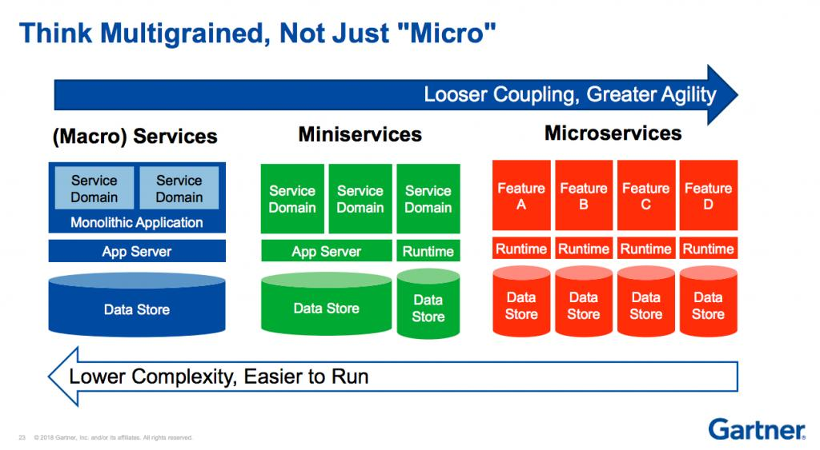
MEMBER 1
What is Granularity
Granularity = size and scope of each microservice.
Fine-grained:
many small services
Coarse-grained:
fewer larger services

Slide 4
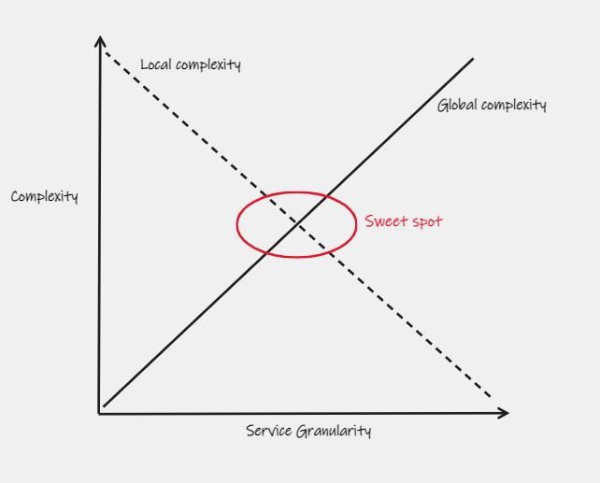
MEMBER 1
Granularity Problem
Too Small Services
communication overhead
complex monitoring
Too Large Services
reduced scalability
harder maintenance

Slide 5
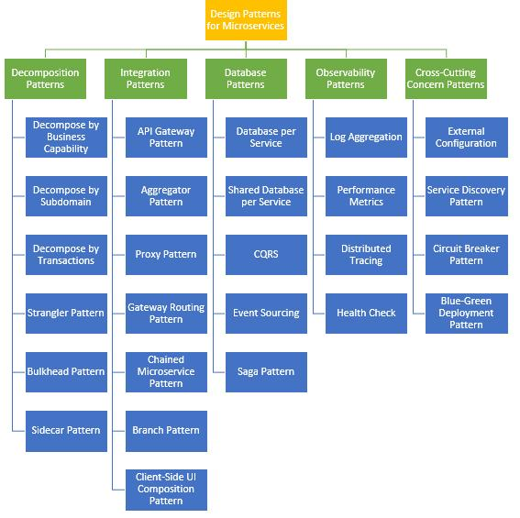
Design Patterns for Microservices
5 Key Categories:
Decomposition – Split services by business logic
Integration – Connect services via API Gateway
Database – Separate data per service
Observability – Monitor, trace & log
Cross-Cutting – Circuit Breaker, Service Discovery

Slide 6
MEMBER 1
Decomposition Approaches

Slide 7
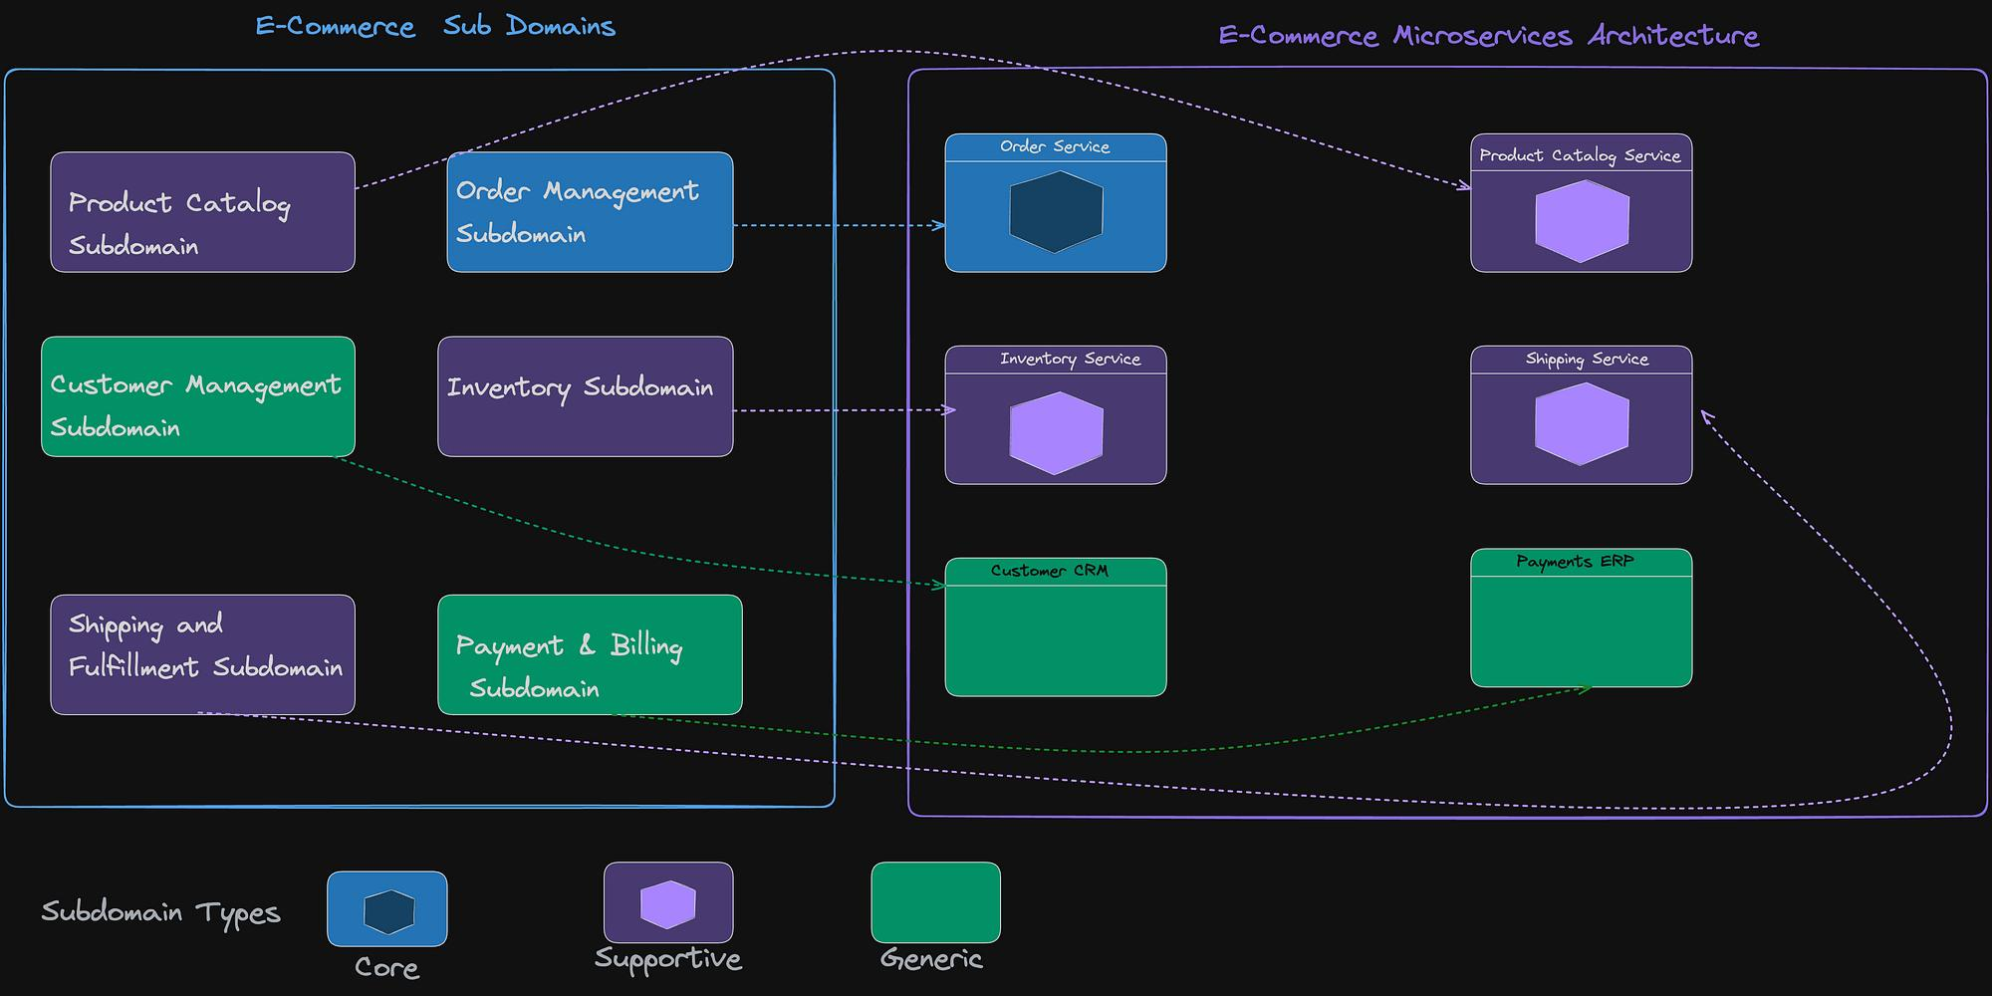
MEMBER 1
Domain-Driven Design (DDD)
E-commerce example:
Order Service
Payment Service
Shipping Service
Services are divided based on business domains.
Uses bounded contexts.

Slide 8
MEMBER 1
Business Capability Decomposition
Split services by business functions.
Independent teams can manage services.
Example
Inventory
Customer Management
Billing

Slide 9
MEMBER 1
Functional Decomposition
Services separated by technical functions.
Easier initial implementation.
Cons
strong coupling risk

Slide 10
Comparison Between Approaches
Approach | Advantages | Disadvantages
DDD | scalable | complex
Functional | simple | coupling
Business | aligned with org | harder integration

Slide 11
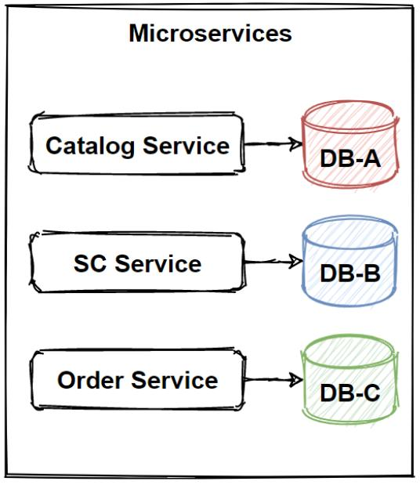
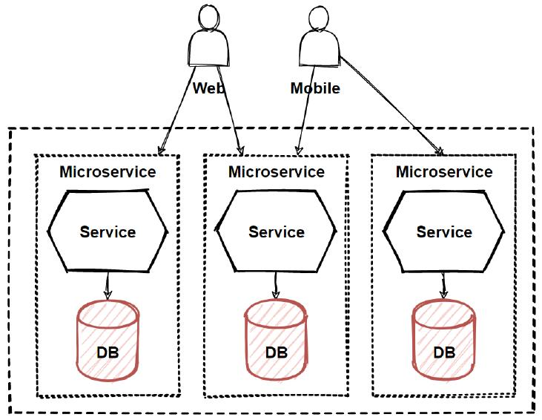
MEMBER 1
Data-Driven Decomposition
Services designed around data ownership.
Each service controls its own database.
Separate DBs per service.

Slide 12
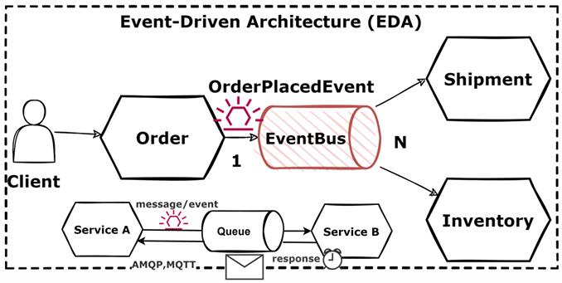
MEMBER 1
Event-Driven Decomposition
Services communicate using events.
Asynchronous communication.
Example
Order Created → Payment Processed → Notification Sent
Diagram
Event bus architecture.

Slide 13
MEMBER 1
AI/ML-Based Decomposition
Machine learning analyzes:
coupling
runtime traces
service dependencies
Mention
clustering algorithms
trace analysis
Diagram
AI analyzing service graph.

Slide 14
MEMBER 1
Challenges in Decomposition
Service dependency complexity
Data consistency
Latency
Monitoring difficulty
Visual
Problem icons or risk chart.

Slide 15
MEMBER 1
Database Connection

Slide 16
MEMBER 1
Database per Service
Every service owns its database.
Better isolation and scalability.
Pros
independent deployment
fault isolation
Cons
harder joins

Slide 17
MEMBER 1
Shared Database Pattern
Multiple services share one DB.
Pros
easier transactions
Cons
tight coupling

Slide 18
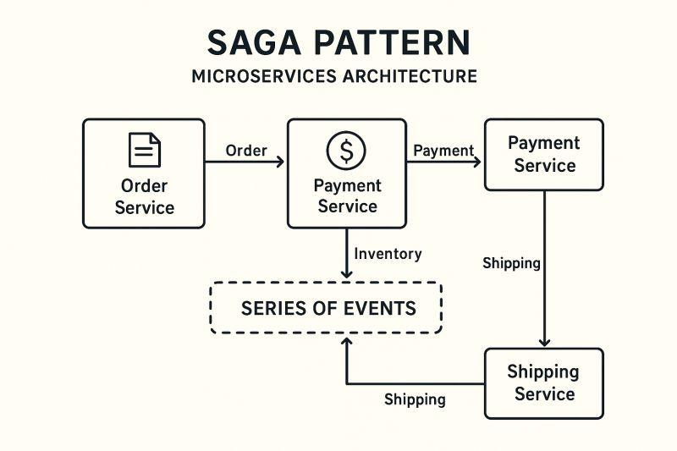
MEMBER 1
Saga Pattern
Handles distributed transactions.
Uses compensation actions.
Example
Order fails → rollback payment.
Diagram
Saga workflow.

Slide 19
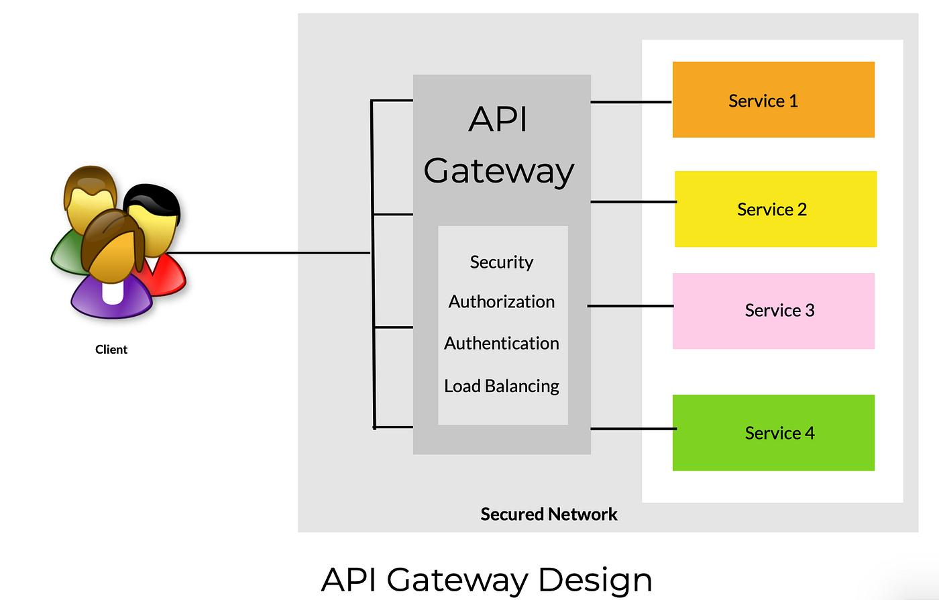
MEMBER 1
API Gateway & Communication
Gateway routes requests.
Centralized authentication and monitoring.
Diagram
Client → API Gateway → Services

Slide 20
MEMBER 1
Impact Analysis
Impact on Performance
Impact on Cost
Impact on Flexibility & Scalability
Impact on Reliability
Costs Increase Due To:
infrastructure
monitoring tools
orchestration
Benefits
efficient scaling
Chart
Cost vs scalability graph.
Faster deployment
Technology diversity
Team independence
Diagram
Independent scaling illustration.
Positive
independent scaling
Negative
network latency
inter-service calls
Chart
Latency comparison chart.
Advantages
fault isolation
Challenges
cascading failures
Mention
Circuit Breaker Pattern.
Diagram
Failure isolation example.

Slide 21
MEMBER 1
Proposed Solution + Evaluation

Slide 22
MEMBER 1
Proposed GODF Framework
Contribution
We propose the Granularity Optimization Decision Framework (GODF): a multi-signal approach that ingests structural, runtime, and organizational data to bridge the business-technical gap.
Structural
Runtime
Code coupling metrics.
Trace frequency graphs.

Slide 23
MEMBER 1
Architecture Diagram
Framework components:
Data Collector
Analyzer
Decision Engine
Output Services
Diagram
System architecture block diagram.
•
•
•
•

Slide 24
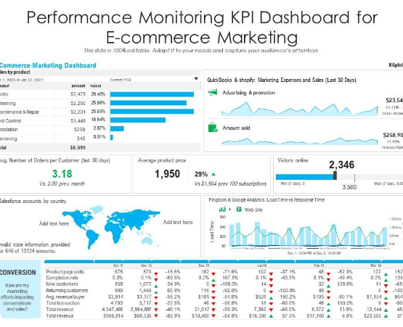
MEMBER 4
Use Case: ShopFlow
Experimental Platform
Production e-commerce platform with 120,000 daily users. Covers 8 domains (Catalog, Checkout, etc.)
Diverse traffic: 60% browsing, 30% transactional, 10% batch updates.

Slide 25
MEMBER 1
Presentation Scope
•
Approaches for Decomposition (DDD, SNAP, ML)
•
Goal
Database Connection and Ownership Patterns
•
Demonstrate how multi-objective balance leads to superior architectural health.
Impact on Performance, Cost, and Reliability
•
Case Study: ShopFlow Production Platform

Slide 26
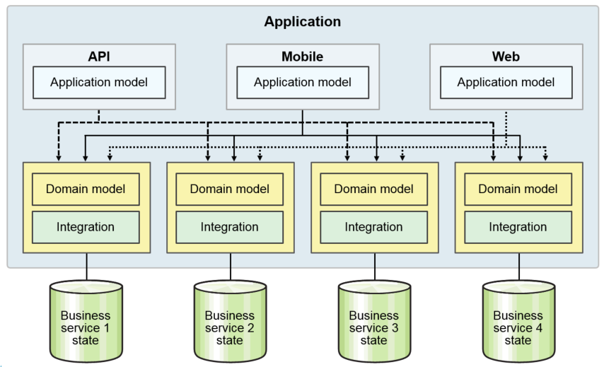
MEMBER 2
Domain-Driven Design (DDD)
The foundational qualitative approach for identifying service boundaries based on business subdomains.
•
Bounded Contexts: Defining systemic boundaries where a domain model is valid.
•
Strength: High maintainability and semantic cohesion.
•
Weakness: Ignores runtime performance.

Slide 27
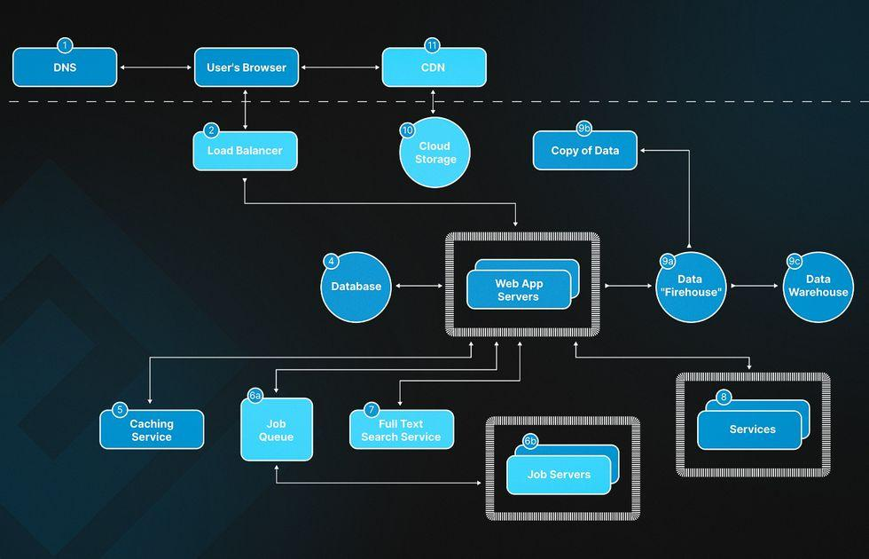

MEMBER 2
SNAP & Network Analysis
Structural Partitioning
Modeling software as a directed graph where nodes are classes and edges are method calls.
•
Uses PageRank and Betweenness centrality.
•
Identifies "God Classes" to break bottlenecks.
•
Focuses on modularity and fine granularity.

Slide 28
MEMBER 2
ML & Graph Clustering
Automated ID
Deep Learning
Using algorithms like DBSCAN and K-Means for unsupervised identification.
Graph Neural Networks (GNNs) learn latent representations of code.
The Gap
Technical coupling methods often create "Distributed Monoliths" because they ignore the business context and organizational structure.

Slide 29
MEMBER 2
The Microservices Premium
6x
Economic Constraints
Operational costs are estimated 3.75x to 6x higher than monoliths. This drives the "Right-Sizing" imperative.
•
Granularity Saturation: Point where new services cost more than they benefit.
Infrastructure Cost
•
The Great Consolidation: 2025 trend toward merging chatty services.

Slide 30
MEMBER 3
The GODF Pipeline
3-Phase Processing
How we ingest signals to produce architectural recommendations.
1. Ingestion
2. Scoring
Static code, runtime traces, and Git history.
Multi-signal affinity mapping between service units.

Slide 31
MEMBER 3
Multi-Signal Scoring
•
Static Coupling: Class imports and data-model dependencies.
Affinity Threshold
•
Units with θ > 50 calls/s are candidates for consolidation to eliminate distribution tax.
Runtime Frequency: Synchronous call volume between modules.
•
Team Signals: Authorship overlap from version-control.

Slide 32
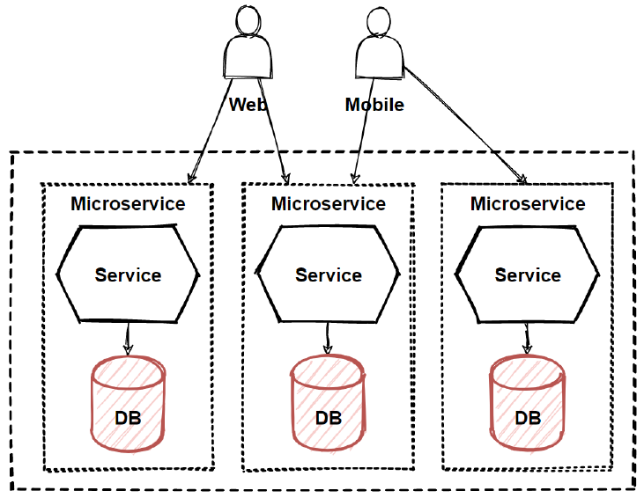
MEMBER 3
Database Connectivity
A critical view of granularity is data ownership. GODF ingests shared data-model metrics to avoid "Data Coupling".
•
Database per Service: Ensures loose coupling.
•
Shared Database: A common anti-pattern that creates distributed monoliths.
•
Data Weight (w8): Ingested to detect cross-domain table dependencies.

Slide 33
MEMBER 3
Optimization Objective
F=P-J
Maximize Benefit (P)
Minimize Cost (J)
Performance + Stability + Business Value.
Infrastructure + Latency + Complexity.

Slide 34
MEMBER 4
Infrastructure Setup
Nodes
Orchestration
12 x (8 vCPU, 32 GB RAM)
Kubernetes 1.29 + Istio 1.18
Fault Injection
Monitoring
Chaos Mesh 2.6
Prometheus & Jaeger Tracing

Slide 35
MEMBER 4
Evaluation Metrics
•
Avg. Latency (p50): E2E checkout response at gateway.
•
Deploy Time: Commit-to-prod healthy wall-clock time.
•
Fault Isolation: % of failures not propagated through mesh.
•
Team Autonomy: Likert survey on ownership clarity.

Slide 36
MEMBER 4
Experimental Scenarios
Comparison of service counts across different methodologies applied to ShopFlow:
Scenario | Methodology | Service Count
A: Baseline | Status Quo (Informal DDD) | 34 Services
B: Formal DDD | Expert Event Storming | 28 Services
C: ML Clust. | Spectral Clustering (Hard) | 31 Services
D: GODF | Our Multi-Signal Engine | 26 Services

Slide 37
MEMBER 5
Impact: Performance
31%
Result Analysis
GODF achieved 33ms checkout latency (Baseline was 48ms).
•
Consolidated Catalog-Inventory affinity pairs.
•
Eliminated 3 synchronous network hops per session.
Latency Reduction

Slide 38
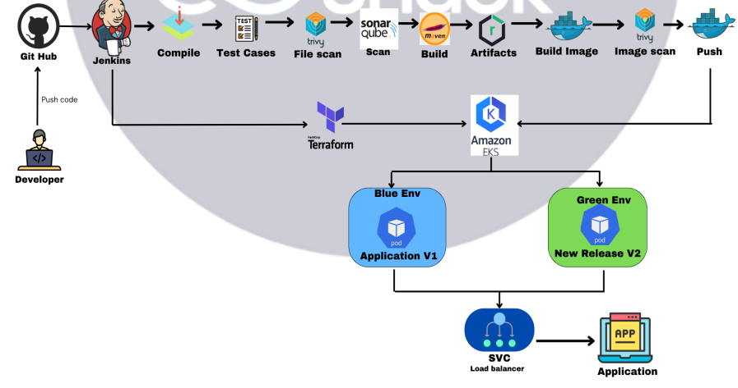
MEMBER 5
Impact: Reliability
Fault Isolation Score
91%
Improvement (150pp over baseline).
By replacing sync Checkout-to-Rec dependencies with asynchronous event-driven models.

Slide 39

MEMBER 5
Impact: Flexibility
Team Autonomy
110%
Autonomy Gain (Survey score 2.1 → 4.4).
GODF boundaries align with development-team authorship structures, reducing cross-team blockers.

Slide 40
MEMBER 5
Impact: Cost Efficiency
Deployment Speedup
GODF reduced deploy pipeline time from 42 to 24 minutes (43% reduction).
Lower service fan-out means fewer dependent pipelines are triggered per feature release, saving compute cost and dev time.

Slide 41
MEMBER 6
Result Synergy
Multi-Signal vs Single-Signal
DDD captures business but ignores runtime; ML minimizes coupling but ignores teams. GODF's hybrid scoring is the only scenario that improved all 5 metrics simultaneously.

Slide 42
MEMBER 6
Shadow Deployment
•
Acceptance: Architects accepted 9 out of 11 GODF recommendations (82%).
•
Speed: Automated analysis took 40 mins vs 80 person-hours for manual DDD workshops.

Slide 43
MEMBER 6
Internal & External Validity
Internal
External
Locust simulations model peak production load but rare high-cost operations (bulk order imports) may be under-sampled.
ShopFlow is a retail monolith. High-frequency financial trading or real-time IoT domains might require different weighting.

Slide 44
MEMBER 6
Construct Validity
•
Autonomy Score: Likert scales subject to bias; mitigated by PR turnaround time triangulation.
•
Git Authorship: Used as proxy for team structure; may lag behind organizational re-orgs.

Slide 45
MEMBER 1
Conclusion & Future work
Key Takeaway
Microservice granularity is not a static choice. Optimal health requires continuous, multi-signal evaluation.
d-GODF (Dynamic)
Future work involves runtime adaptation to adjust boundaries as business traffic shifts in real-time.

Slide 46
Thank You! Any Questions?

